Slide 1
Similarity of the Neighbourhoods in Toronto and New York for Emigration Purposes Coursera and IBM Capstone Project
Firaz Ahmad

Slide 2
Introduction
New York and Toronto are the financial capitals of their respective countries
Many people emigrate between New York and Toronto
This project is intended to use Unsupervised Machine Learning to cluster similar neighbourhoods in terms of venues nearby to assist in people looking to emigrate in finding a suitable neighbourhood to relocate to

Slide 3
Data
The data to be used in the project consists of:
1) Toronto neighbourhood data including the Boroughs and Neighbourhoods from the following Wikipedia page: https://en.wikipedia.org/wiki/List_of_postal_codes_of_Canada:_M
2) New York neighbourhood data including the Neighbourhoods and latitudes and longitudes from the following JSON file: https://cf-courses-data.s3.us.cloud-object-storage.appdomain.cloud/IBMDeveloperSkillsNetwork-DS0701EN-SkillsNetwork/labs/newyork_data.json
3) Latitude and Longitude data from Geocoder or a CSV file to obtain the location data for each neighbourhood in Toronto
4) Foursquare data consisting of the nearby venues obtained using the Foursquare API with the latitude and longitude data

Slide 4
Methodology
The data will be imported from the data sources
The data will be examined and explored using techniques such as visualisation
Upon inspection, the data will be pre-processed to convert it from it's raw form to a form which can be analysed. Any categorical variables will be encoded using One Hot Encoding.
The data will be combined using the relevant criteria in order to allow the neighbourhoods to be compared and clustered using K-Means Clustering based on their similarities in terms of venues.
The results will be visualised and explored to allow the analysis and learnings to be easily understood and evaluated to allow comparisons of neighbourhoods in both Toronto and New York.

Slide 5

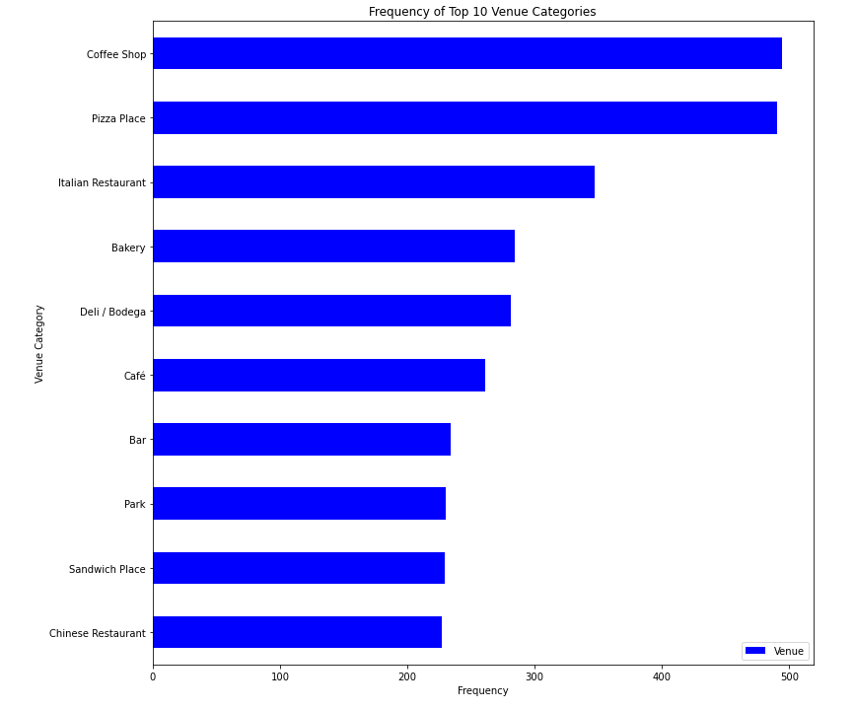
Results
The data obtained from the Foursquare API data can be used to plot the top 10 most frequent venue categories across all of the neighbourhoods

Slide 6
Results
The algorithm was able to cluster similar neighbourhoods into the following broad categories:
Cluster 1 - Restaurants and Convenience Stores
Cluster 2 - Fitness and Nature
Cluster 3 - Attractions and Landmarks
Cluster 4 - Sports and Entertainment

Slide 7
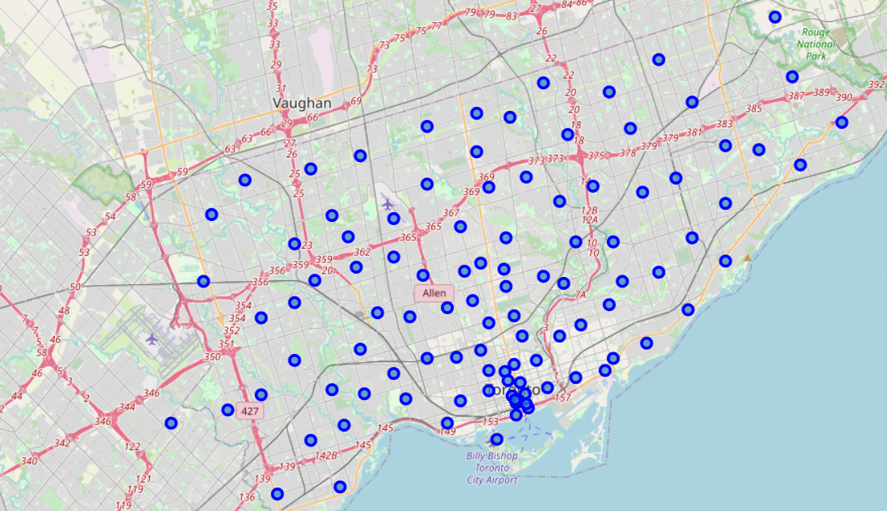
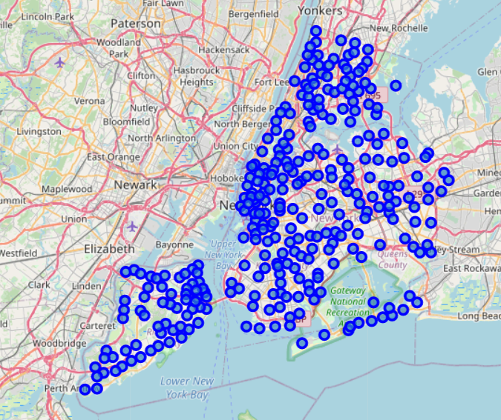
Results - Before Clustering
Toronto
New York

Slide 8
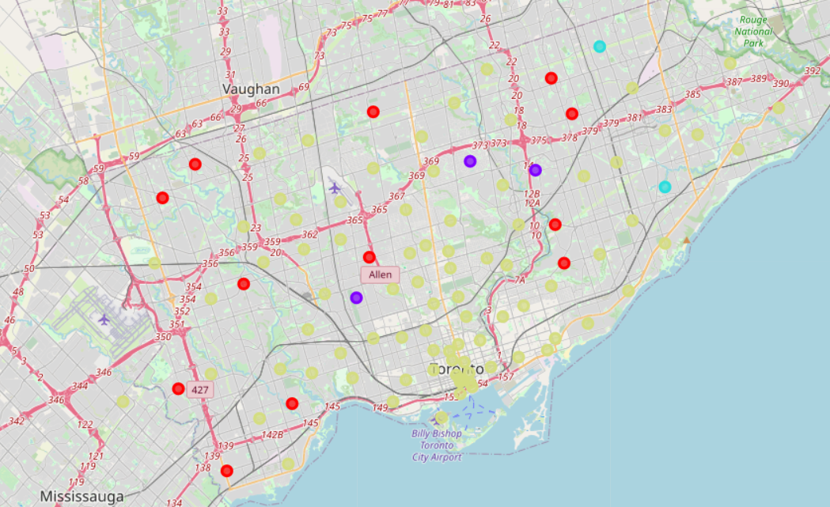
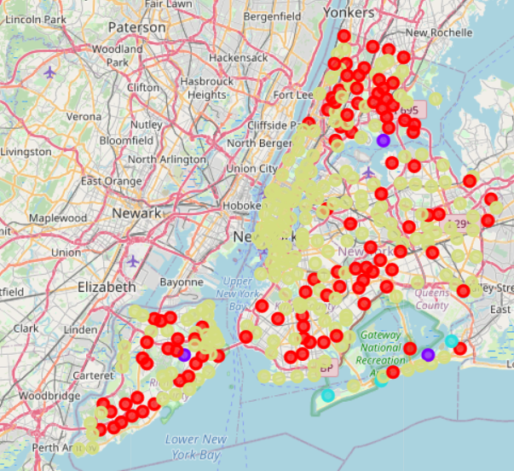
Results - After Clustering
Toronto
New York
Red - Cluster 1 - Restaurants and Convenience Stores
Purple - Cluster 2 - Fitness and Nature
Blue - Cluster 3 - Attractions and Landmarks
Yellow - Cluster 4 - Sports and Entertainment

Slide 9
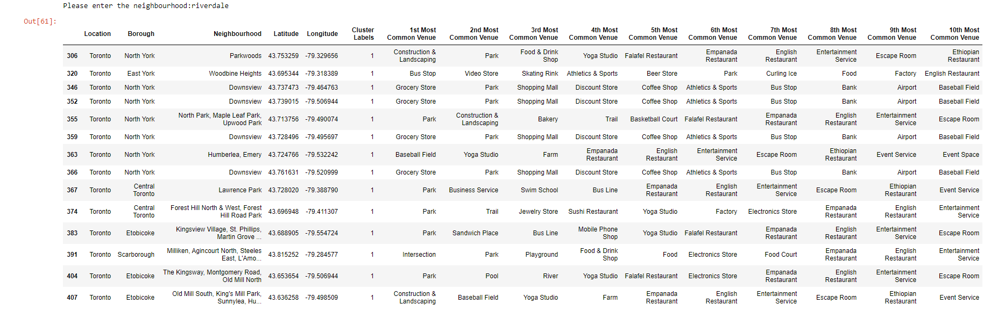
Results
Now that the neighbourhoods have been clustered, the data can be explored by the user.
The user can enter the neighbourhood they currently reside in and a table will be shown of the similar neighbourhoods in the same cluster in the other location

Slide 10
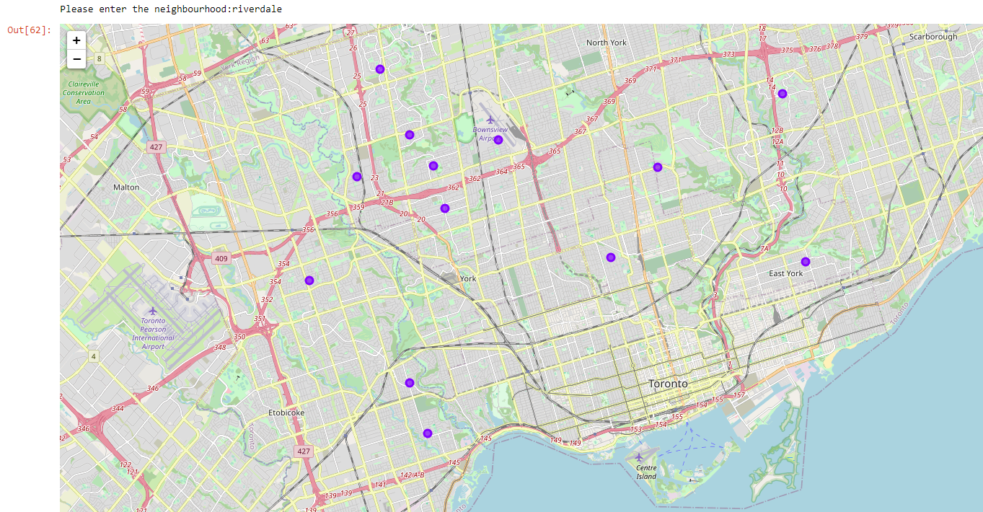
Results
The user can also enter the neighbourhood they currently reside in and a map will be shown of the similar neighbourhoods in the same cluster in the other location

Slide 11
Discussion
I have implemented Unsupervised Machine Learning in the form of K-Means Clustering in order to group neighbourhoods across New York and Toronto according to their similarity in terms of venues nearby.
The data was visualised and explored before implementing the algorithm to ensure that it was suitable. This led to the pre-processing and refinement of the data to ensure the data could be utilised and any redundant or erroneous data was removed.
The algorithm can be further enhanced by providing additional data such as the average property prices and average income as well as the crime statistics of the neighbourhoods, which would allow for enhanced analysis and comparisons. This may lead to an increased number of clusters which would give the user an even better understanding of the neighbourhoods to explore further and assist in narrowing down the search for a suitable area.

Slide 12
Conclusion
In conclusion, the data was successfully imported, pre-processed and K-Means Clustering implemented to cluster the neighbourhoods into 4 categories.
Although the clustering was successful, there is scope for improvement and further analysis possibly using even more data such as financial data to help the user make an informed decision as to which neighbourhood to relocate to.
Nevertheless, the analysis provides an adequate starting point for anybody interested in emigrating between New York and Toronto and allows the exploration and visualisation of the data in a quick and easy manner.

